Slide 1
Plants
For parents
Thank you for supporting your child’s learning in science.
Before the session:
Please read slide 2 so you know what your child is learning and what you need to get ready.
As an alternative to lined paper, slide 6 may be printed for your child to record on.
During the session:
Share the learning intentions on slide 2.
Support your child with the main activities on slides 3 to 6, as needed.
Slide 7 has an optional activity.
Slide 8 has a glossary of key terms.
Reviewing with your child:
Slide 9 gives an idea of what your child may produce.
Exploring seed dispersal in plants
Year 3
Age 7-8

Slide 2
Plants
Logo for section to sit inside roundel
Exploring seed dispersal in plants
Key Learning
The life cycle of flowering plants includes germination, pollination, seed formation and seed dispersal.
Seeds need to be scattered or dispersed so they can germinate away from the parent plant. This seed dispersal can be done by animals, water or the wind.
Activities (pages 3-6): 40 mins
You will need lined paper and a pencil.
Alternatively, you may like to print page 6 as a worksheet.
Find out more…
There is an optional activity on page 7 to explore some more unusual ways seeds are dispersed.
I can…
explain why and how the seeds of plants are dispersed.
2

Slide 3
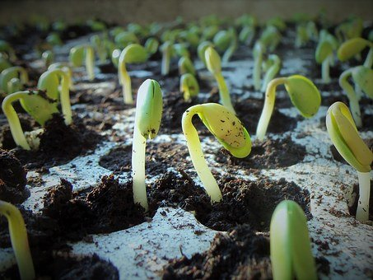
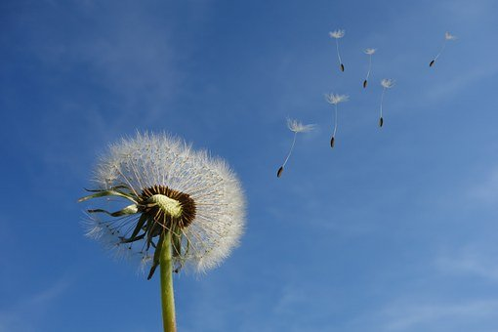
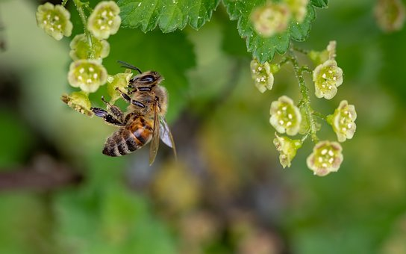
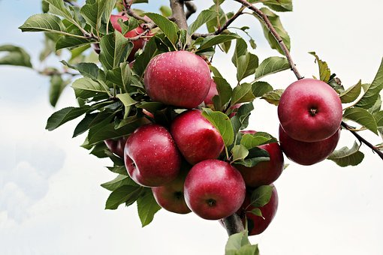
Explore, review, think, talk….
Logo for section to sit inside roundel
What do you already know about the life cycle of a plant?
(5 - 10 minutes)
Watch this clip from ‘Explorify’.
https://explorify.wellcome.ac.uk/en/activities/whats-going-on/shooting-sprouts/classroom?view-type=public
Which stage of a plant’s life cycle is shown?
Can you name the parts of the plant?
What do you think will happen next?
Now watch this clip about plant lifecycles: https://www.bbc.co.uk/bitesize/clips/zgqyrdm
Germination
Pollination
Seed dispersal
Seed dispersal is one stage in the
life cycle of a plant.
Fruit formation
3

Slide 4
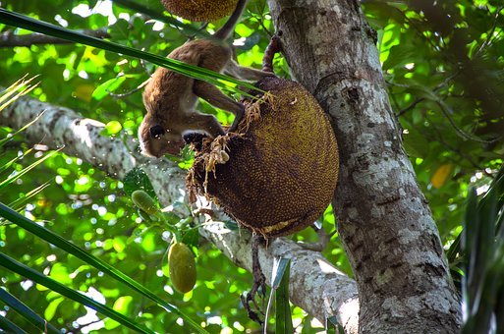
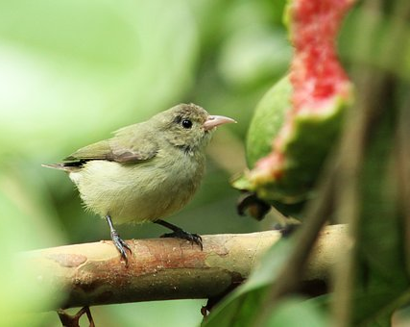
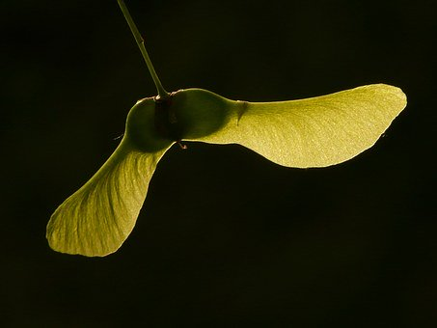
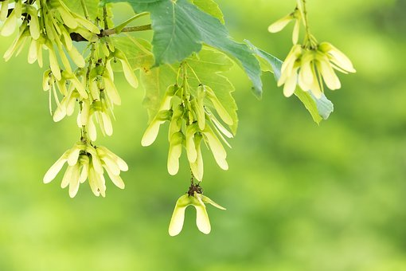
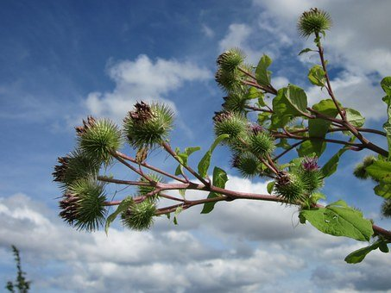
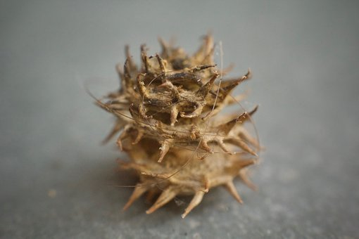
Different types of seed dispersal
Logo for section to sit inside roundel
Comparing some different ways plants disperse their seeds
(10 minutes)
Seeds can be dispersed by animals.
Seeds dispersed by the wind often have ‘parachutes’ or ‘helicopters’ to help them.
Look at the seeds in this clip.
https://www.bbc.co.uk/programmes/p00lxw4t
Birds and other animals often eat the fruit of a plant. The seed is not digested and can travel large distances before it is ‘deposited’! Watch: https://www.bbc.co.uk/programmes/p00lxv9z
Other seeds have sticky burrs or spikes. They catch on the fur or feet of animals and are carried away.
Think or talk about the differences between the seeds which are dispersed by animals and by the wind.
4

Slide 5
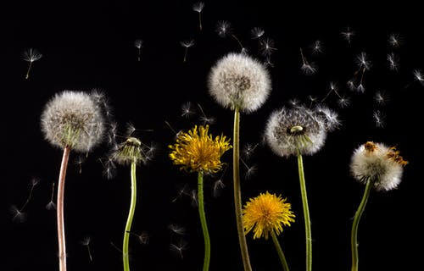
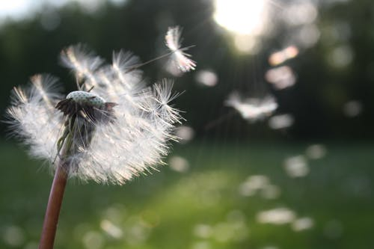
Why is seed dispersal important for plants?
Logo for section to sit inside roundel
Asking and answering questions about seed dispersal
(page 5-6: 15-20 minutes)
Dandelions use the wind to disperse their seeds. Watch this clip:
https://www.bbc.co.uk/bitesize/clips/zs9c87h
Once fertilisation has taken place the plant will produce seeds.
Plants such as dandelions often use wind to transport seeds.
As there are so many adult plants in one place there is no space for the next generation of plants to grow.
The dandelion therefore needs the wind to carry the seeds far away.
The wind drops the seeds and new plants are formed and the whole process starts again.
Answer these questions about dandelions:
How does the dandelion seed travel?
What device does it have to help it to move?
Why does the dandelion seed need to move?
What happens when the seed is dropped?
Now try asking and answering your own questions about blackberry seed dispersal.
5

Slide 6
Using what you have learnt, answer the questions about dandelion seed dispersal.
Now try to ask and answer your own questions about blackberry seed dispersal.
Word bank:
seed, disperse, wind, animal, bird, parachute, float, glide, berries, red, black, space to grow, not digested, germinate, grow.
I can explain why and how the seeds of plants are dispersed.
Dandelion seed dispersal questions | Answers
How does the dandelion seed travel?
What device does it have to help it to move?
Why does the dandelion seed need to move?
What happens when the seed is dropped?
Blackberry seed dispersal questions | Answers
6

Slide 7
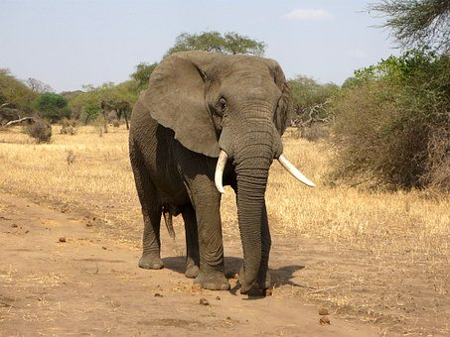
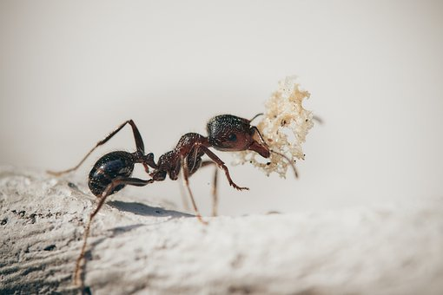
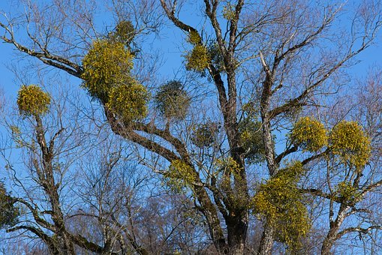
Find out more…
Logo for section to sit inside roundel
Find out about some unusual ways that seeds are dispersed by animals
Some seeds are dispersed by animals in more unusual ways. Watch these three clips from ‘Private Life of Plants’.
Think about the journey of one of these seeds:
A seed from an acacia tree which is eaten by an elephant.
A seed which falls to the ground and is found by ants.
A seed in a mistletoe fruit which is eaten by the mistletoe bird.
Write a story about the journey of the seed and how it successfully starts to grow into a new plant.
You may like to imagine you are the seed!
https://www.bbc.co.uk/programmes/p006999s
https://www.bbc.co.uk/programmes/p00lxvrk
https://www.bbc.co.uk/programmes/p00crfc4
7

Slide 8
Glossary of terms
Life cycle: Every plant has a life cycle which represents the stages the plant goes through during its life.
Germination is when a seed or bulb starts to grow into a new plant.
Pollination is when pollen is carried from the male part to the female part of a plant, usually by insects or the wind.
Fruit formation: Flowers form fruits after pollination. Seeds develop inside the fruit.
Seed dispersal is when seeds are carried away from the parent plant, often by the wind, by water or by animals. This enables the seeds to germinate away from the parent plant.
8

Slide 9
Possible learning outcome for reviewing your work. I can explain why and how the seeds of plants are dispersed.
Dandelions are an example of seed dispersal by the wind. Blackberries are an example of seed dispersal by animals.
Dandelion seed dispersal questions | Answers
How does the dandelion seed travel? | The dandelion seed travels by being picked up by the wind.
What device does it have to help it to move? | The dandelion seed has a parachute to help the wind move it like an umbrella.
Why does the dandelion seed need to move? | The area is too packed with plants for any new seeds to grow there so it must move away.
What happens when the seed is dropped? | The seed will drop and germinate and the roots will anchor into the soil.
Blackberry seed dispersal questions | Answers
Which type of animal helps to disperse blackberry seeds? | Birds help to disperse blackberry seeds by eating them.
Why do the fruits of blackberries turn black when they are ripe? | Birds are attracted to colours which they can see easily, like black and red.
Why do birds eat lots of blackberries? | The blackberries taste sweet and are a good food source for the birds.
What happens to the fruit after it is eaten? | The flesh is digested by the bird. The seeds are not digested and are ‘pooped out’ later.
There are many possible questions you can ask about how and why seeds are dispersed.
You may like to think about questions for other plants you saw in the clips.
9

